Slide 1

RAMP in Retrospect
David Patterson
August 25, 2010

Slide 2
Outline
Beginning and Original Vision
Successes
Problems and Mistaken Assumptions
New Direction: FPGA Simulators
Observations

Slide 3
Where did RAMP come from?
June 7, 2005 ISCA Panel Session, 2:30-4PM
  “Chip Multiprocessors are here, but where are the threads?”

Slide 4
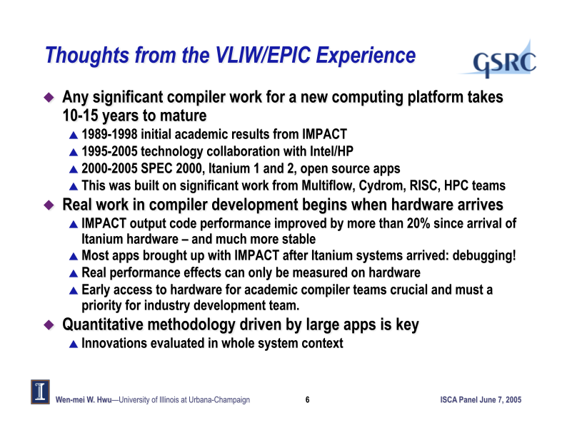

Slide 5
Where did RAMP come from?
(cont’d)
Hallway conversations that evening (> 4PM) and next day (<noon end of ISCA) with Krste Asanovíc (MIT), Dave Patterson (UCB), …
Krste recruited from “Workshop on Architec-ture Research using FPGAs” community
  Derek Chiou (Texas), James Hoe (CMU), Christos Kozyrakis (Stanford), Shih-Lien Lu (Intel), Mark Oskin (Washington),
  and John Wawrzynek (Berkeley, PI)
Met at Berkeley and wrote NSF proposal based on BEE2 board at Berkeley in July/August; funded March 2006

Slide 6

Problems with “Manycore” Sea Change
(Original RAMP Vision)
Algorithms, Programming Languages, Compilers, Operating Systems, Architectures, Libraries, …
not ready for 1000 CPUs / chip
≈ Only companies can build HW, and it takes years
Software people don’t start working hard until hardware arrives
  3 months after HW arrives, SW people list everything that must be fixed, then we all wait 4 years for next iteration of HW/SW
How get 1000 CPU systems in hands of researchers to innovate in timely fashion on in algorithms, compilers, languages, OS, architectures, … ?
Can avoid waiting years between HW/SW iterations?

Slide 7
Build Academic Manycore from FPGAs
(Original RAMP Vision)
As ≈ 16 CPUs will fit in Field Programmable Gate Array (FPGA), 1000-CPU system from ≈ 64 FPGAs?
  8 32-bit simple “soft core” RISC at 100MHz in 2004 (Virtex-II)
  FPGA generations every 1.5 yrs; ≈ 2X CPUs, ≈ 1.2X clock rate
HW research community does logic design (“gate shareware”) to create out-of-the-box, Manycore
  E.g., 1000 processor, standard ISA binary-compatible, 64-bit,
  cache-coherent supercomputer @ ≈ 150 MHz/CPU in 2007
  RAMPants: 10 faculty at Berkeley, CMU, MIT, Stanford, Texas, and Washington
“Research Accelerator for Multiple Processors” as a vehicle to attract many to parallel challenge

Slide 8
Why Good for Research Manycore?
(Original RAMP Vision)
 | SMP | Cluster | Simulate | RAMP
Scalability (1k CPUs) | C | A | A | A
Cost (1k CPUs) | F ($40M) | C ($2-3M) | A+ ($0M) | A ($0.1-0.2M)
Cost of ownership | A | D | A | A
Power/Space (kilowatts, racks) | D (120 kw, 12 racks) | D (120 kw, 12 racks) | A+ (.1 kw, 0.1 racks) | A (1.5 kw, 0.3 racks)
Community | D | A | A | A
Observability | D | C | A+ | A+
Reproducibility | B | D | A+ | A+
Reconfigurability | D | C | A+ | A+
Credibility | A+ | A+ | F | B+/A-
Perform. (clock) | A (2 GHz) | A (3 GHz) | F (0 GHz) | C (0.1 GHz)
GPA | C | B- | B | A-

Slide 9
Software Architecture Model Execution (SAME)
 | Median Instructions Simulated/ Benchmark | Median #Cores | Median Instructions Simulated/ Core
ISCA 1998 | 267M | 1 | 267M
ISCA 2008 | 825M | 16 | 100M
Effect is dramatically shorter (~10 ms) simulation runs

Slide 10
Why RAMP More Credible?
(Original RAMP Vision)
Starting point for processor is debugged design from Industry in HDL
Fast enough that can run more software,
more experiments than simulators
Design flow, CAD similar to real hardware
  Logic synthesis, place and route, timing analysis
HDL units implement operation vs.
a high-level description of function
  Model queuing delays at buffers by building real buffers
Must work well enough to run OS
  Can’t go backwards in time, which simulators can unintentionally
Can measure anything as sanity checks

Slide 11
Outline
Beginning and Original Vision
Successes
Problems and Mistaken Assumptions
New Direction: FPGA Simulators
Observations

Slide 12
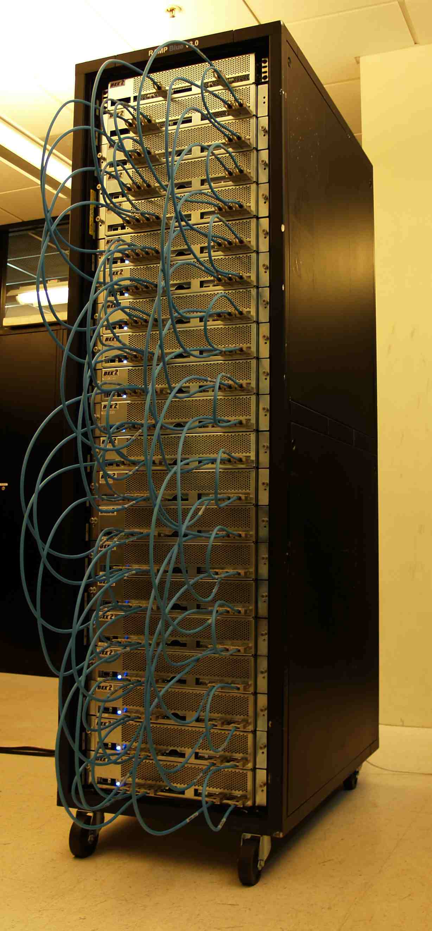
RAMP Blue 1008 core MPP
Core is softcore MicroBlaze
(32-bit Xilinx RISC)
12 MicroBlaze cores / FPGA
21 BEE2s (84 FPGAs)
x 12 FPGAs/module
= 1008 cores @ 100MHz
  $10k/board
Full star-connection between modules
Works Jan 2007; runs NAS benchmarks in UPC
Final RAMP Blue demo in poster session today!
Krasnov, Burke, Schultz, Wawrzynek at Berkeley

Slide 13
RAMP Red: Transactional Memory
8 CPUs with 32KB L1 data-cache with Transactional Memory support (Kozyrakis, Olukotun… at Stanford)
  CPUs are hardcoded PowerPC405, Emulated FPU
  UMA access to shared memory (no L2 yet)
  Caches and memory operate at 100MHz
  Links between FPGAs run at 200MHz
  CPUs operate at 300MHz
A separate, 9th, processor runs OS (PowerPC Linux)
It works: runs SPLASH-2 benchmarks, AI apps,
C-version of SpecJBB2000 (3-tier-like benchmark)
1st Transactional Memory Computer!
Transactional Memory RAMP runs 100x faster than simulator on a Apple 2GHz G5 (PowerPC)

Slide 14
Academic / Industry Cooperation
Cooperation between universities: Berkeley, CMU, MIT, Texas, Washington
Cooperation between companies: Intel, IBM, Microsoft, Sun, Xilinx, …
Offspring from marriage of Academia and Industry: BEEcube

Slide 15
Other successes
RAMP Orange (Texas): FAST x86 software simulator + FPGA for cycle accurate timing
ProtoFlex (CMU) SIMICS + FPGA:
16 processors, 40X faster than simulator
OpenSPARC: Opensource T1 processor
DOE: RAMP for HW/SW co-development BEFORE buying hardware (Yelick’s talk)
Datacenter-in-a-box: 10K processors + networking simulator (Zhangxi Tan’s demo)
BEE3 – Microsoft + BEEcube

Slide 16
BEE3 Around the World
Anadolu University
Barcelona Super Computing
Cambridge University
University of Cyprus
Tshinghua University
University of Alabama at Huntsville
Leiden University
MIT
University of Michigan
Pennsylvania State University
Stanford University
Technische Darmsstadt
Tokyo University
Peking University
CMC Microsystems
Thales Group
Sun Microsystems
Microsoft Corporation
L3 Communications
UC Berkeley
Lawrence Berkeley National Laboratory
UC Los Angeles
UC San Diego
North Carolina State University
University of Pennsylvania
Fort George G. Meade
GE Global Research
The Aerospace Corporation

Slide 17
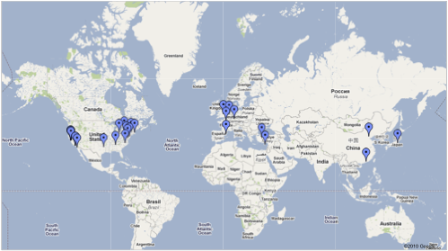
Sun Never Sets on BEE3

Slide 18
Outline
Beginning and Original Vision
Successes
Problems and Mistaken Assumptions
New Direction: FPGA Simulators
Observations

Slide 19
Problems and mistaken assumptions
“Starting point for processor is debugged design from Industry in HDL”
Tapeout everyday => its easy to fix =>debugged as well as software
(but not done by world class programmers)
Most “gateware” IP blocks are starting points for a working block
Others are large, brittle, monolithic blocks of HDL that are hard to subset

Slide 20
Mistaken Assumptions:
FPGA CAD Tools as good as ASIC
“Design flow, CAD similar to real hardware”
  Compared to ASIC tools, FPGA tools are immature
  Encountered 84 formally-tracked bugs developing RAMP Gold (Including several in the formal verification tools!)
  Highly frustrating to many, Biggest barrier by far
Making internal formats proprietary prevented
“Mead-Conway” effect on VLSI era of 1980s
  “I can do it better” and they did => reinvent CAD industry
  FPGA = no academic is allowed to try to do it better

Slide 21
Mistaken Assumptions: FPGAs are easy
“Architecture Researchers can program FPGAs”
Reaction of some: “Too hard for me to write (or even modify)”
  Do we have a generation of La-Z-Boy architecture researchers spoiled by ILP/cache studies using just software simulators?
  Don’t know which end of soldering iron to grab??
Make sure our universities don’t graduate any more La-Z-Boy architecture researchers!

Slide 22
Problems and mistaken assumptions
“RAMP consortium will share IP”
Due to differences in:
  Instruction Sets (x86 vs. SPARC)
  Number of target cores (Multi- vs. Manycore)
  HDL (BlueSpec vs. Verilong)
Ended up sharing ideas, experiences vs. IP

Slide 23
Problems and mistaken assumptions
“HDL units implement operation vs.
a high-level description of function”
  E.g., Model queuing delays at buffers by building real buffers
Since couldn’t simply cut and paste IP, needed a new solution
Build a architecture simulator in FPGAs vs. build an FPGA computer
FPGA Architecture Model Execution (FAME)
Took a while to figure out what to do and how to do it

Slide 24
FAME Design Space
Three dimensions of FAME simulators
  Direct or Decoupled: does one host cycle model one target cycle?
  Full RTL or Abstract RTL?
  Host Single-threaded or Host Multi-threaded?
See ISCA paper for a FAME taxonomy!
“A Case for FAME: FPGA Architecture Model Execution” by Zhangxi Tan, Andrew Waterman, Henry Cook, Sarah Bird, Krste Asanović, David Patterson,
Proc. Int’l Symposium On Computer Architecture, June 2010.

Slide 25



FAME Dimension 1: Direct vs. Decoupled
Direct FAME: compile target RTL to FPGA
Problem: common ASIC structures map poorly to FPGAs
Solution: resource-efficient multi-cycle FPGA mapping
Decoupled FAME: decouple host cycles from target cycles
  Full RTL still modeled, so timing accuracy still guaranteed
R1
R2
R3
R4
W1
W2
Rd1
Rd2
Rd3
Rd4
R1
R2
W1
Rd1
Rd2
RegFile
RegFile
FSM
Target System Regfile
Decoupled Host Implementation

Slide 26

FAME Dim. 2:Full RTL vs. Abstract RTL
Decoupled FAME models full RTL of target machine
  Don’t have full RTL in initial design phase
  Full RTL is too much work for design space exploration
Abstract FAME: model the target RTL at high level
  For example, split timing and functional models (à la SAME)
  Also enables runtime parameterization: run different simulations without re-synthesizing the design
Advantages of Abstract FAME come at cost: model verification
  Timing of abstract model not guaranteed to match target machine
Functional
Model
Target
RTL
Abstraction
Timing
Model

Slide 27
FAME Dimension 3: Single- or
Multi-threaded Host
Problem: can’t fit big manycore on FPGA, even abstracted
Problem: long host latencies reduce utilization
Solution: host-multithreading
Target Model
CPU1
CPU2
CPU3
CPU4
Multithreaded Emulation Engine (on FPGA)
PC
1
X
PC
1
GPR
I$
IR
GPR
Single hardware pipeline with multiple copies
of CPU state
PC
1
GPR
PC
1
GPR1
D$
Y
+1
2
2

Slide 28
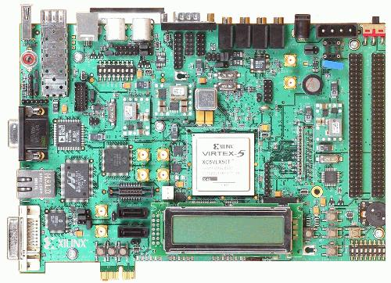
RAMP Gold: A Multithreaded FAME Simulator
Rapid accurate simulation of manycore architectural ideas using FPGAs
Initial version models 64 cores of SPARC v8 with shared memory system on $750 board
Hardware FPU, MMU, boots OS.
FAME 1 => BEE3, FAME 7 => XUP
 | Cost | Performance (MIPS) | Simulations per day
Simics (SAME) | $2,000 | 0.1 - 1 | 1
RAMP Gold (FAME) | $2,000 + $750 | 50 - 100 | 250

Slide 29
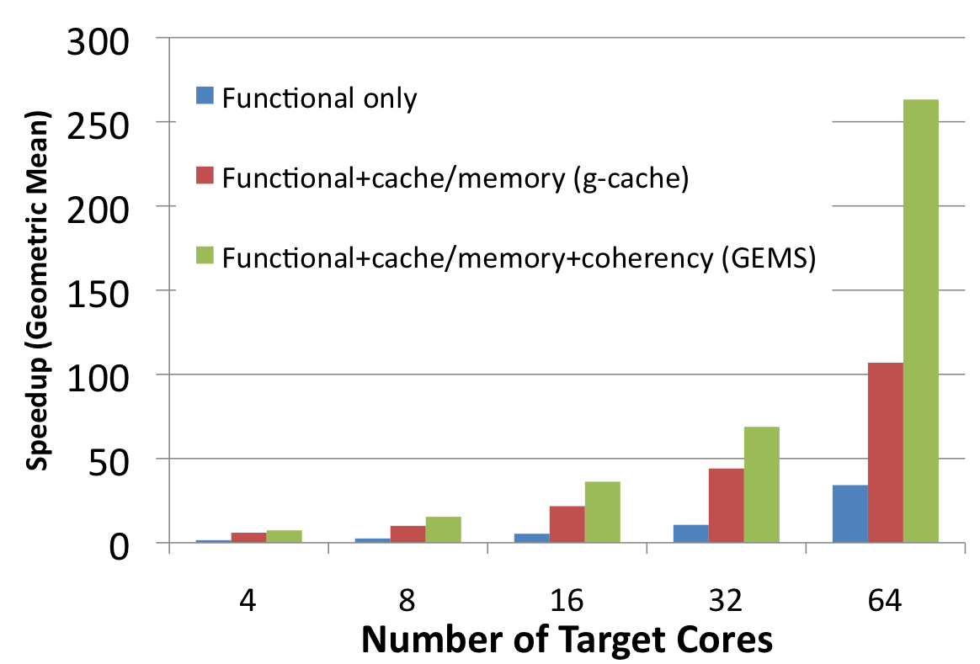
RAMP Gold Performance
FAME (RAMP Gold) vs. SAME (Simics) Performance
  PARSEC parallel benchmarks, large input sets
  >250x faster than full system simulator for a 64-core target system

Slide 30
Researcher Productivity is Inversely Proportional to Latency
Simulation latency is even more important than throughput (for OS/Arch study)
  How long before experimenter gets feedback?
  How many experimenter-days are wasted if there was an error in the experimental setup?
 | Median Latency (days) | Maximum Latency (days)
FAME | 0.04 (~1 hour) | 0.12 (~3 hours)
SAME | 7.50 | 33.20

Slide 31
Conclusion
This is research, not product develop
– often end up in different place than expect
Eventually delivered on original inspiration
“How get 1000 CPU systems in hands of researchers to innovate in timely fashion on in algorithms, compilers, languages, OS, architectures, … ?”
“Can avoid waiting years between HW/SW iterations?”
Need to simulate trillions of instructions to figure out how to best transition of whole IT technology base to parallelism
SAME
FAME

Slide 32
Potential to Accelerate Manycore
(Original RAMP Vision)
With RAMP: Fast, wide-ranging exploration of HW/SW options + head-to-head competitions to determine winners and losers
  Common artifact for HW and SW researchers ⇒ innovate across HW/SW boundaries
  Minutes vs. years between “HW generations”
  Cheap, small, low power ⇒ Every dept owns one
  FTP supercomputer overnight, check claims locally
  Emulate any Manycore ⇒ aid to teaching parallelism
  If HP, IBM, Intel, M/S, Sun, …had RAMP boxes
  ⇒ Easier to carefully evaluate research claims
  ⇒ Help technology transfer
Without RAMP: One Best Shot + Field of Dreams?

